Slide 1
pollution
Pollution has become a major concern today. Man has interfered too much with nature. As a result, the environment including air, water, soil, etc… has been polluted.
If the environment is polluted, all sorts of life- human, animal, and vegetation are affected directly or indirectly. It is the introduction of harmful substances or pollutants into the environment.

Slide 2
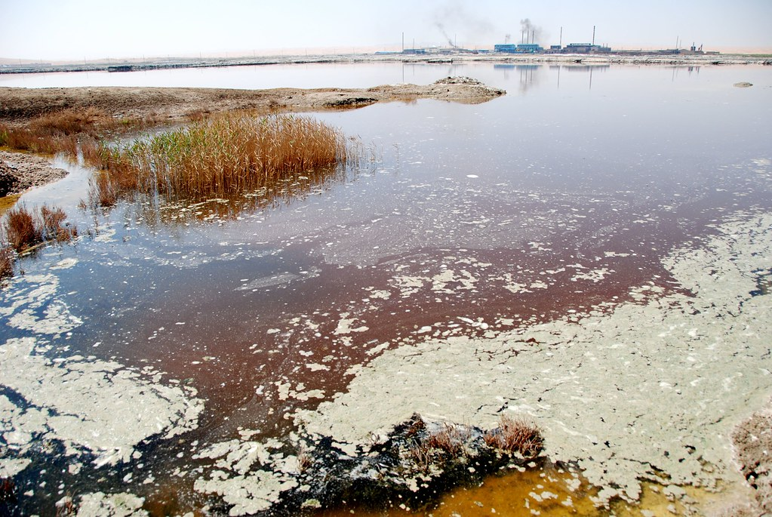
Water pollution
Water Pollution refers to the presence of impurities and harmful elements in the water. It is a source of many deadly diseases that cause harm, diseases, and even kill human civilization. The polluted water is not fit for drinking and is harmful to living beings such as animals, birds, and human beings Water Pollution refers to the presence of impurities and harmful elements in the water. It is a source of many deadly diseases that cause harm, diseases, and even kill human civilization. The polluted water is not fit for drinking and is harmful to living beings such as animals, birds, and human beings
This Photo by Unknown Author is licensed under CC BY-SA-NC

Slide 3
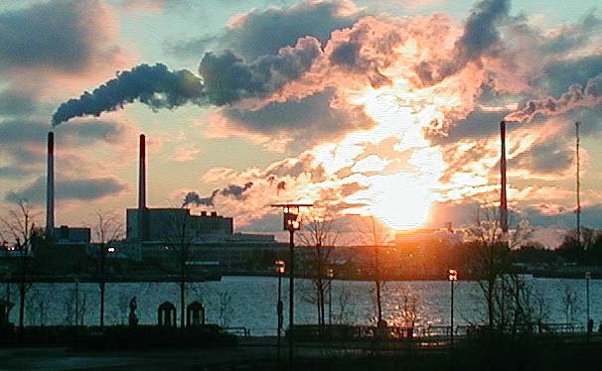
Air pollution
Air pollution has become a serious threat at the current time all over the world. Because of the huge level of industrialization, harmful substances like carbon monoxide, carbon dioxide, CFC, sulfur dioxide, etc. mix with the air. Poisonous gases released from motor vehicles, burning of fossil fuels also cause air pollution. The ozone layer is getting affected too much by air pollution which causes serious disturbances to the environment. Air pollution has become a serious threat at the current time all over the world. Because of the huge level of industrialization, harmful substances like carbon monoxide, carbon dioxide, CFC, sulfur dioxide, etc. mix with the air.
This Photo by Unknown Author is licensed under CC BY

Slide 4
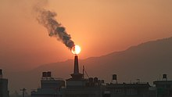
Noise pollution
Noise pollution is a type of pollution that is caused due to loud, unpleasant noises. The adverse effects of noise pollution are not visible, just like the effects of water and air pollution, but it is equally threatening to the environment. Noise pollution is hazardous to our health. It is not merely an unpleasant and irritating sound for our ears. Our bodies and mind are harmed as a result of it. Noise pollution not only affects the ears but also harms concentration.

Slide 5
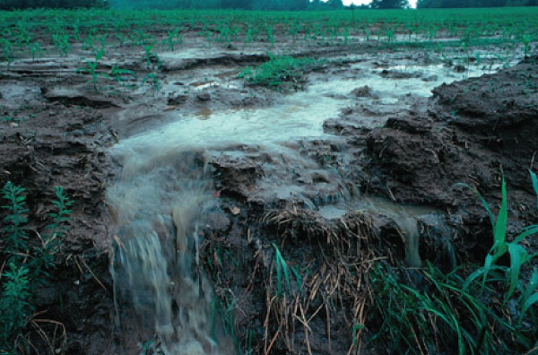
Soil Pollution
It portrays the tainting of soil because of the presence of harmful substances like unreasonable utilization of manures and pesticides, deforestation, modern waste, and so on…Soil pollution is an element that is utilized for the decay of soil because of surface, mineral, or quality substance of soil is decreased.
Additionally, this upsets the natural equilibrium of the living beings dependent on the dirt. Also, there are antagonistic impacts of soil contamination on the development of plants.

Slide 6
Plastic pollution

